Slide 1
Secure data hiding in images using steganography
CAPSTONE PROJECT
Presented By:
Student Name : Shaik Ayisha Sadiq
College Name & Department : Vasireddy Venkatadri Institute of Technology, CSE

Slide 2
OUTLINE
Problem Statement
Technology used
Wow factor
End users
Result
Conclusion
Git-hub Link
Future scope

Slide 3
Problem Statement
Digital communication needs secure ways to transmit confidential information.
Traditional encryption methods can raise suspicion when intercepted.
Steganography hides data within images, making it undetectable to outsiders.
This project ensures secret message transmission without raising suspicion.

Slide 4
Technology used
Programming Language: Python
Libraries: OpenCV (cv2), OS, String
Concepts: Image processing, ASCII encoding
Platform: Windows

Slide 5
Wow factors
Uses pixel manipulation to hide secret messages within images.
Requires a passcode for decryption, enhancing security.
Stealthy approach: No noticeable change in image quality after encryption.
The encrypted image can be shared like any normal image file.

Slide 6
End users
Cybersecurity professionals for covert communication.
Journalists & whistle blowers for secure message transmission.
Military & intelligence agencies for classified data sharing.
General users looking for privacy in digital communication.

Slide 7
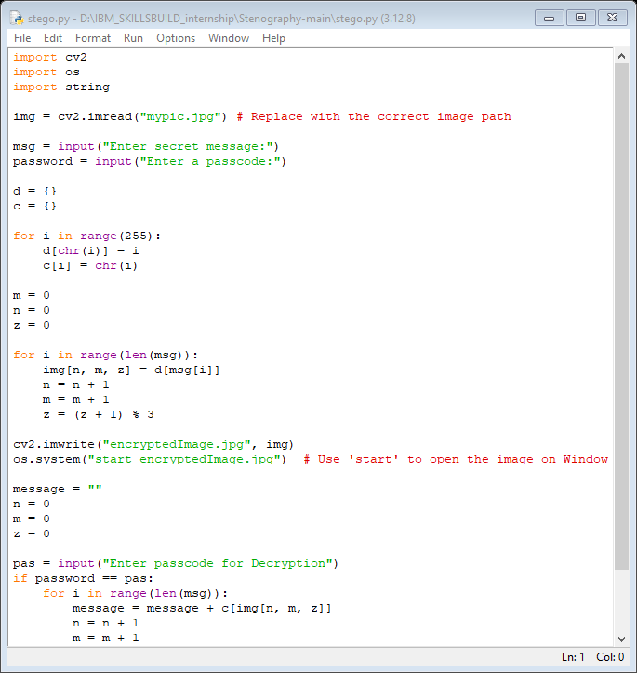
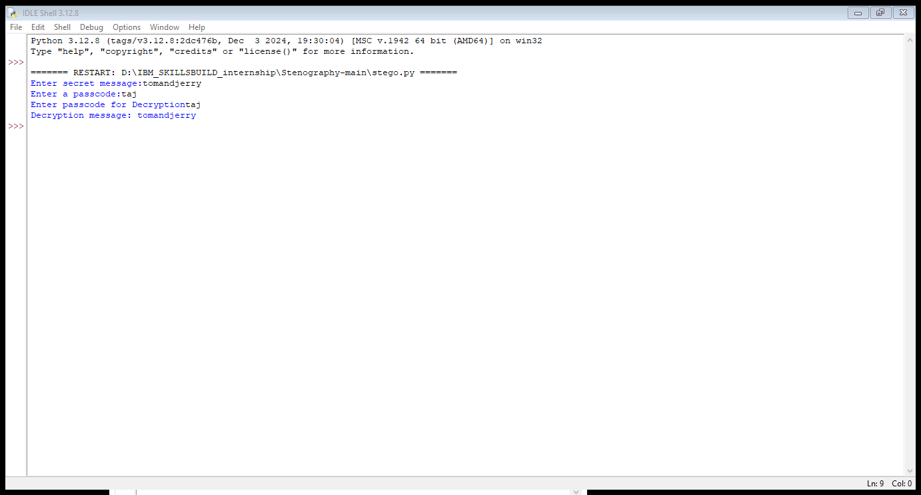
Results

Slide 8


Input :
Output :

Slide 9
Conclusion
Implemented image-based steganography for secure data hiding.
Achieved successful encryption & decryption of messages using passcodes.
Ensured data security and privacy without attracting attention.
The project showcases a simple yet effective method for covert communication.

Slide 10
GitHub Link
https://github.com/Ayisha-Sadiq/aicte_project

Slide 11
Future scope(optional)
Extend the project to video & audio steganography.
Implement deep learning techniques to enhance security.
Improve steganography detection resistance against advanced analysis.
Develop a web-based tool for easier access and usability.

Slide 12
THANK YOU

